Slide 1


Pricing Geometric Asian Options with Jump-Diffusion by Monte Carlo Simulation
Ajay Dugar
December 17th, 2020
Advisor: Dr. Daniel Totouom-Tangho

Slide 2

Background
Why Jump-Diffusion?
What are Asian Options?

Slide 3
Jump-Diffusion
Why Jump-Diffusion?
Shortcomings of other distributions
Normal
Log-Normal
Mathematical Definition
Simple Poisson Process
Compound Poisson Process
Jump-Diffusion
Merton Model
Types of Options
European
American
Asian
Arithmetic
Geometric

Slide 4
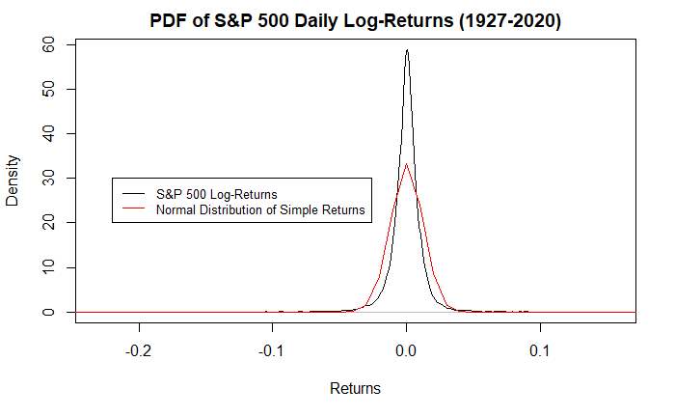
Jump-Diffusion
Normal Distribution
Bachelier (1900) – Absolute Price Changes
Changes in price are relative, not absolute

Slide 5
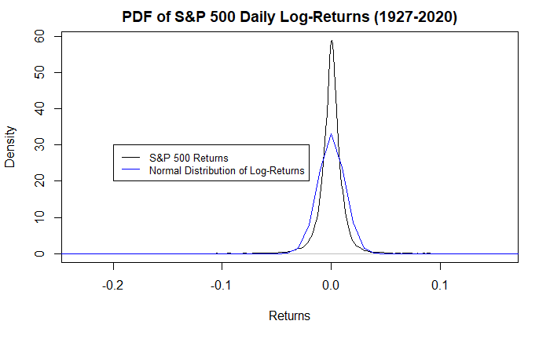
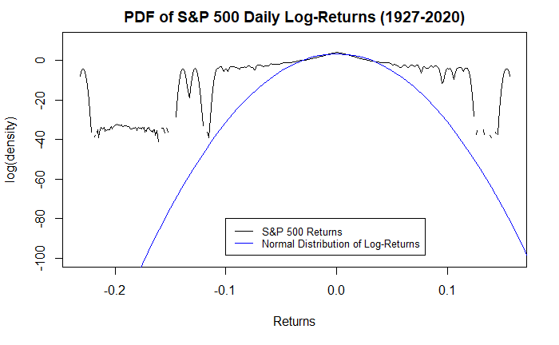
Jump-Diffusion
Log-Normal Distribution
Osborne (1959) or Samuelson (1964)
Doesn’t account for fat-tailed behavior
Prices aren’t continuous*
Notes:
In a select few cases, like high-frequency trading (HFT) this can be waived away, but for the vast majority of modeling and cases, prices tend to be discrete

Slide 6
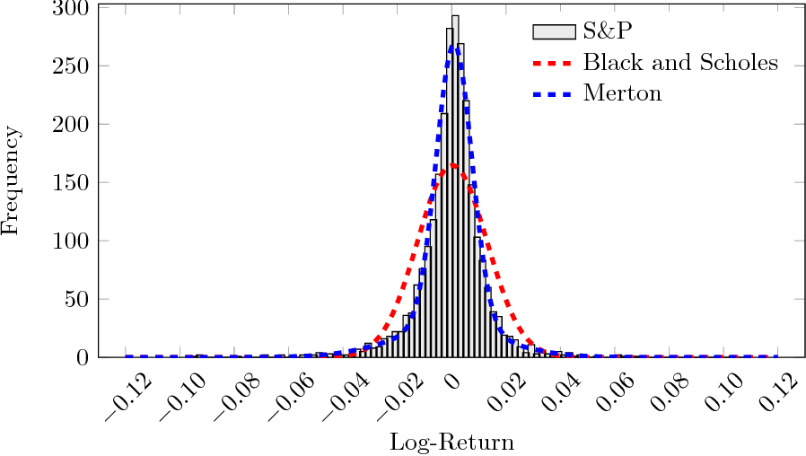
Jump-Diffusion
Jump-Diffusion
Kurtosis of returns
Discrete time process
Highly flexible in terms of behavior

Slide 7
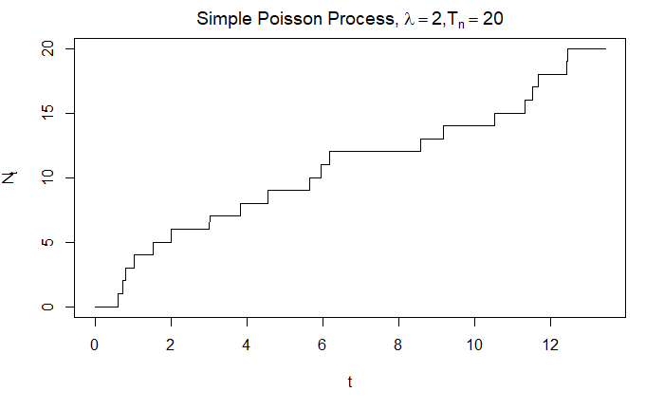
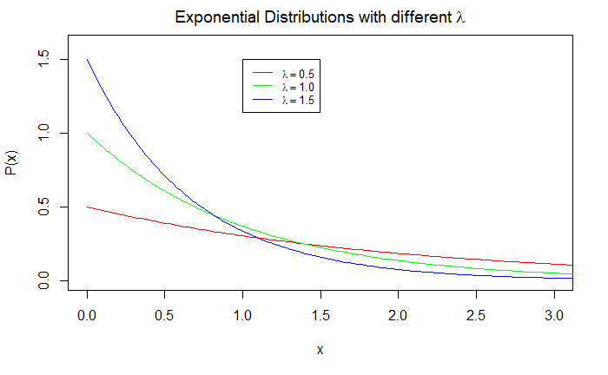
Jump-Diffusion
Simple Poisson Process
Jump size of 1
Exponential distribution for time between jumps

Slide 8
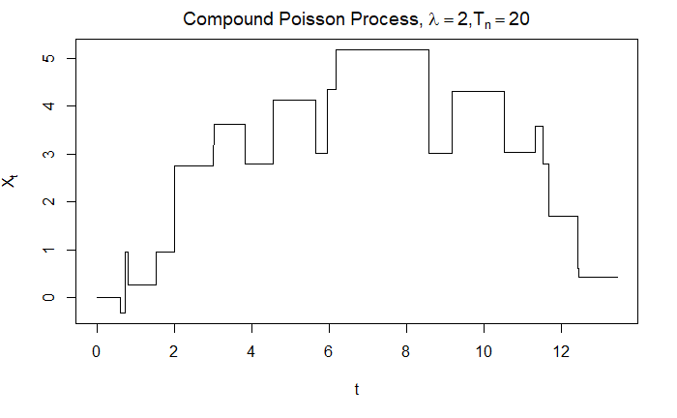
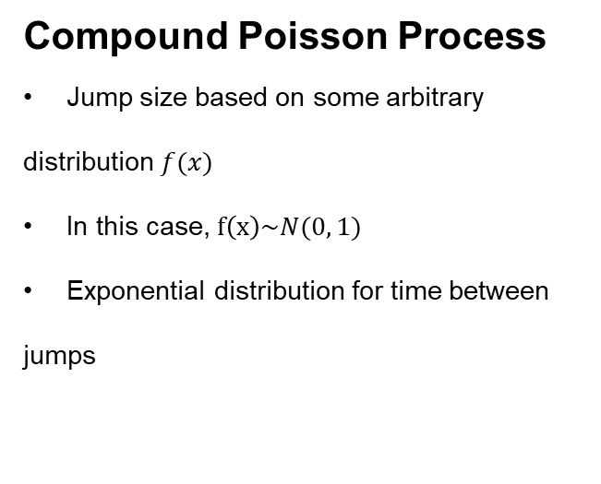
Jump-Diffusion
Compound Poisson Process
Jump size based on some arbitrary distribution $f(x)$
In this case, $f\left(x\right)\sim N(0, 1)$
Exponential distribution for time between jumps

Slide 9
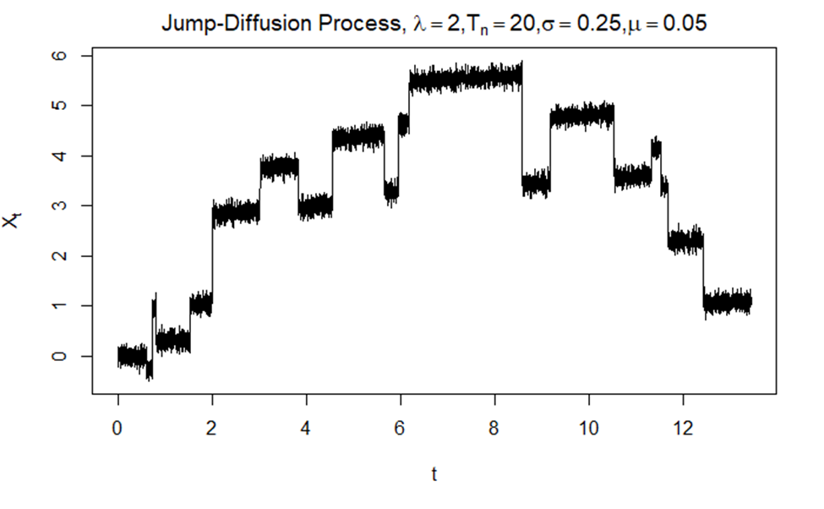
Jump-Diffusion
Jump-Diffusion
Summation of Compound Poisson Process and Brownian motion

Slide 10
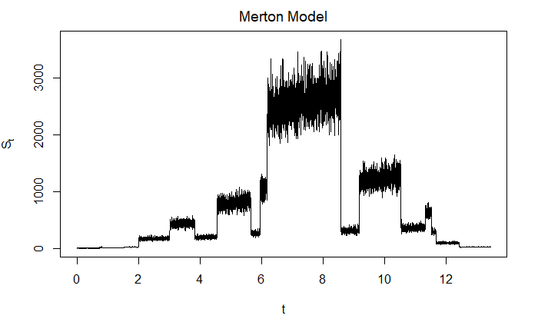

Jump-Diffusion
Merton Model
Exponential a compound Poisson process
$S_{t}=S_{0}e^{X_{t}}$

Slide 11
Asian Options
What are Asian Options?
Types of Options
European
American
Asian
Arithmetic
Geometric

Slide 12
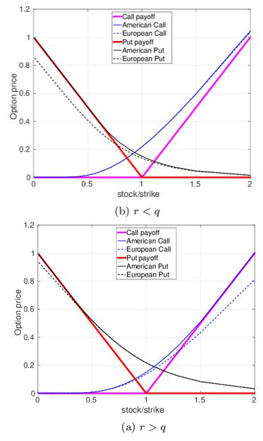
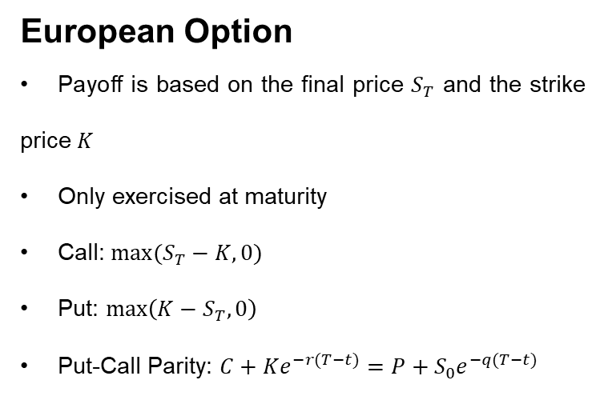
Asian Options
European Option
Payoff is based on the final price $S_{T}$ and the strike price $K$
Only exercised at maturity
Call: $max⁡(S_{T}−K, 0)$
Put: $\max\left(K−S_{T}, 0\right)$
Put-Call Parity: $C+Ke^{−r(T−t)}=P+S_{0}e^{−q(T−t)}$

Slide 13
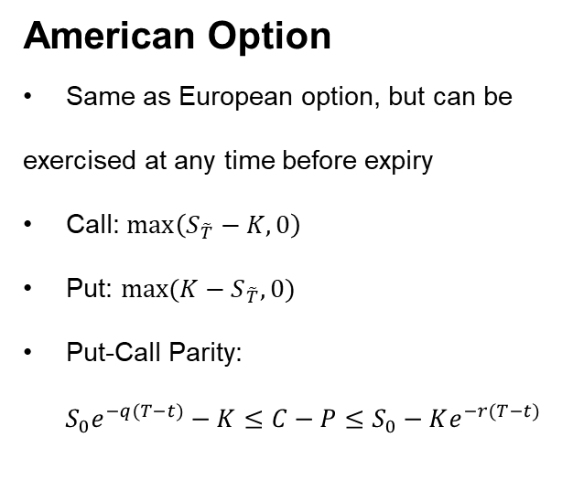
Asian Options
American Option
Same as European option, but can be exercised at any time before expiry
Call: $\max\left(S_{\tilde{T}}−K, 0\right)$
Put: $max⁡({K−S}_{\tilde{T}}, 0)$
Put-Call Parity:
$$S_{0}e^{−q(T−t)}−K≤C−P≤S_{0}−Ke^{−r(T−t)}$$

Slide 14
Asian Options
American Option (Cont.)
Ceteris paribus, between an American and European option, American options will be worth more

Slide 15
Asian Options
Asian Option
Path-dependent, based on the average of the prices of the asset
Ceteris paribus, between an Asian, European, and American options, Asian options will be worth the least because the averaging reduces volatility

Slide 16
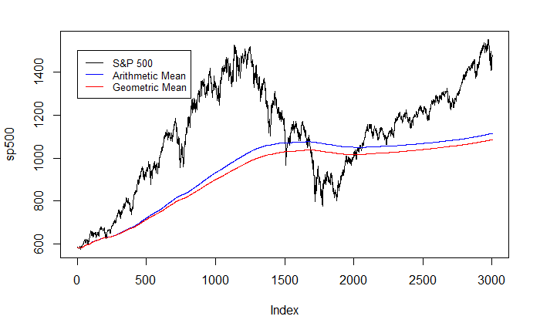
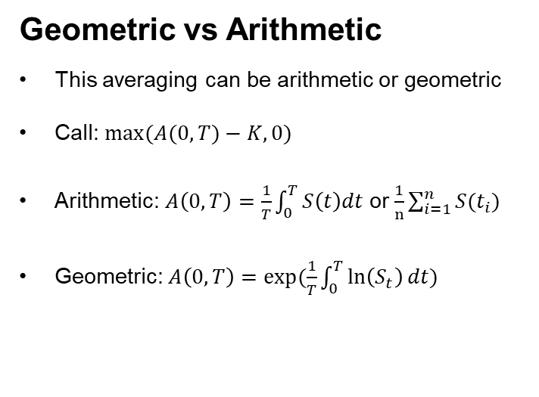

Asian Options
Geometric vs Arithmetic
This averaging can be arithmetic or geometric
Call: $max⁡(A(0, T)−K, 0)$
Arithmetic: $A\left(0, T\right)=\frac{1}{T}\int_{0}^{T}{S\left(t\right)dt}$ or $\frac{1}{n}\sum_{i=1}^{n}{S(t_{i})}$
Geometric: $A\left(0,T\right)=exp⁡(\frac{1}{T}\int_{0}^{T}{\ln\left(S_{t}\right)dt)}$
$$\frac{1}{t}\int_{0}^{t}{S_{u}du}$$

Slide 17
Findings
Closed Form
Monte Carlo

Slide 18
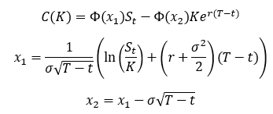
Findings
European Call Option (Underlying is GBM)

Slide 19
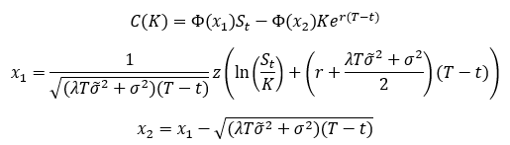
Findings
European Call Option (Underlying is JD)

Slide 20
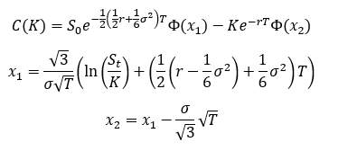
Findings
Geometric Asian Call Option (Underlying is GBM)

Slide 21
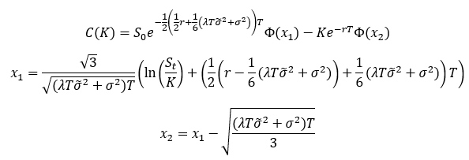
Findings
Geometric Asian Call Option (Underlying is Jump-Diffusion)

Slide 22
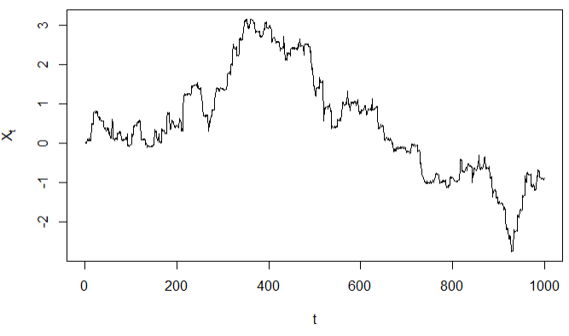
Findings
Simulation

Slide 23
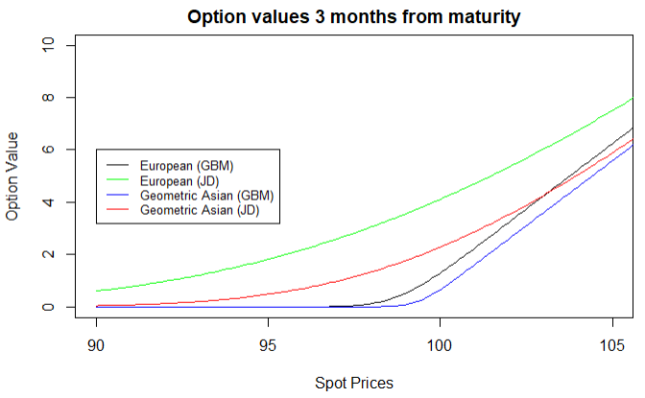
Findings
Simulation

Slide 24
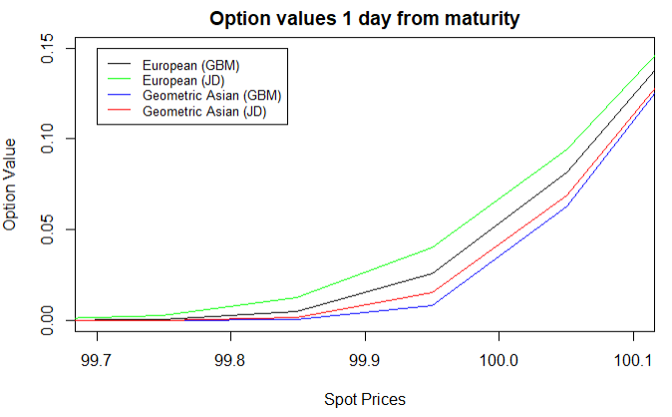
Findings
Simulation

Slide 25
Future Steps
Non-constant volatility
Heston volatility
fBM
Other Exotic Options
Arithmetic Asian
Barrier

Slide 26
Any Questions?

Slide 27
References
R. Merton, Option pricing when underlying stock returns are discontinuous, J. Financial Economics, 3 (1976), pp. 125–144.
P. Carr and D. Madan, Option valuation using the fast Fourier transform, J. Comput. Finance, 2 (1998), pp. 61–73.
R. Cont and P. Tankov, Financial Modelling with Jump Processes, Chapman & Hall / CRC Press, 2004.
P. Tankov, L´evy Processes in Finance: Inverse Problems and Dependence Modelling, PhD thesis, Ecole Polytechnique, France, 2004.
Kemna, A.G.Z.; Vorst, A.C.F.; Rotterdam, E.U.; Instituut, Econometrisch (1990), A Pricing Method for Options Based on Average Asset Values
Osborne, M. (1959). Brownian Motion in the Stock Market. Operations Research, 7(2), 145-173.
Gugole, Nicola. (2016). Merton jump-diffusion model versus the Black and Scholes approach for the log-returns and volatility smile fitting. International Journal of Pure and Applied Mathematics. 109. (2016): 719-736
Tankov, Peter & Voltchkova, Ekaterina. (2009). Jump-difiusion models: a practitioner's guide. Banque et Marchés.

